Slide 1
2023-24 NFHS soccer Rules PowerPoint
Rules Changes
Major Editorial Changes
Points of Emphasis

Slide 2
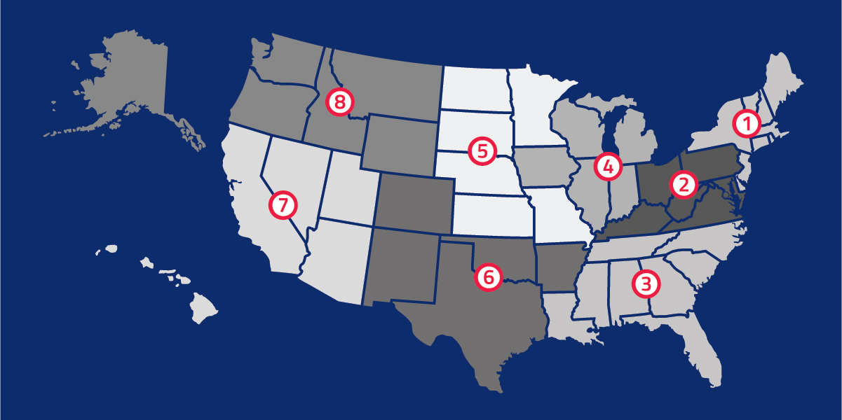
National Federation of
State High School Associations
NFHS (located in Indianapolis, IN – Est. 1920):
  National leader and advocate for
  high school athletics and
  performing arts programs.
  Serves 51 state associations, 19,500
  high schools and 12 million student
  participants.
  Writes playing rules for 17 high school
  sports for boys and girls.
  Offers online education courses for high school coaches,
  officials, parents, students and others.
  Ensures that students have opportunity to enjoy healthy participation, achievement and good sportsmanship in education-based athletics.

Slide 3
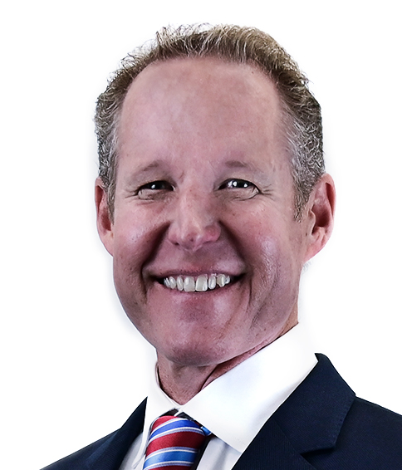
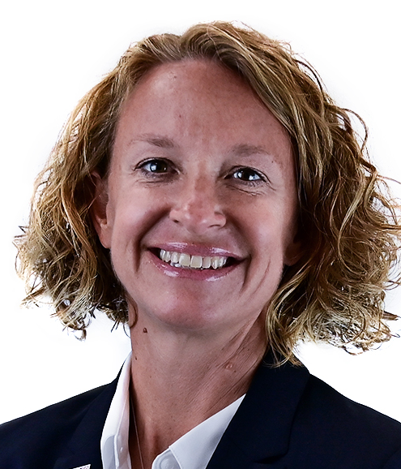

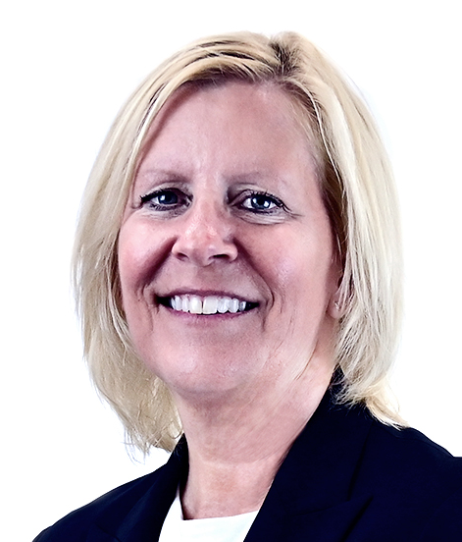
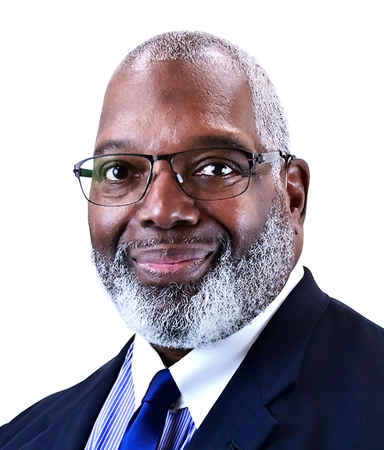


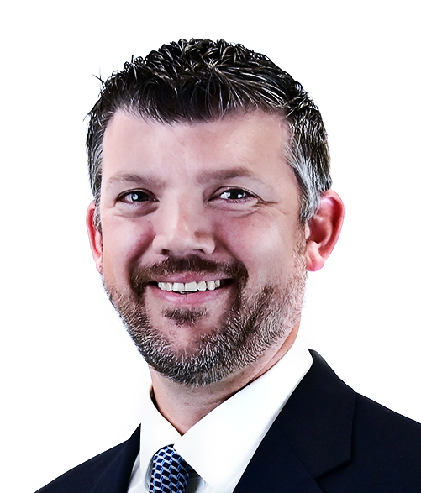
NFHS Rules Review Committee
The NFHS Rules Review Committee is chaired by the chief operating officer and composed of all rules editors. After each committee concludes its deliberations and has adopted its recommended changes for the subsequent year, such revisions will be evaluated by the Rules Review Committee.
Davis Whitfield
Chief Operating Officer
Lindsey Atkinson
Basketball, Girls Lacrosse and Volleyball
Bob Colgate
Football and Sports
Medicine
Sandy Searcy
Softball, Swimming & Diving and Water Polo
Elliot Hopkins
Baseball and Wrestling
Julie Cochran
Cross Country, Gymnastics, Field Hockey, Soccer and
Track & Field
James Weaver
Boys Lacrosse
and Spirit
Dan Schuster
Ice Hockey

Slide 4
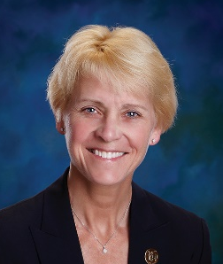


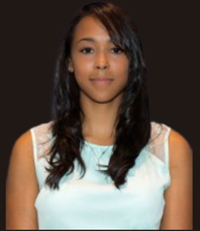

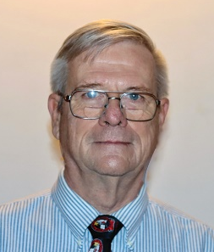
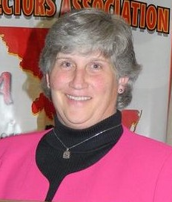
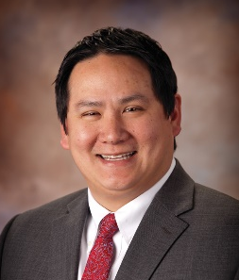
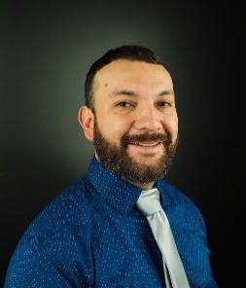
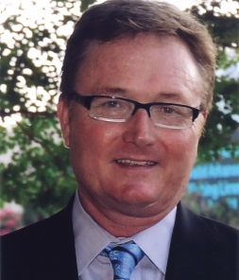
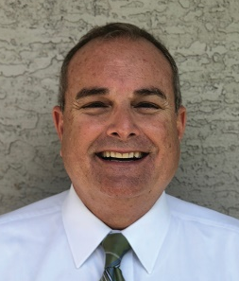

NFhS Rules Committee
Dr. Karissa Niehoff
NFHS
Publisher
Julie Cochran
NFHS
Editor
Dr. Stan Latta
State College, PA
Chair- 2025
Brianna Hines
Woodbridge, VA
Coaches- 2026
Gibby Reynolds
Wilsonville, OR
Officials- 2024
Mike Andrew
Binghamton, NY
Section 1- 2024
Marianne Shultz
Abingdon, MD
Section 2- 2026
Marvin Chou
Montgomery, AL
Section 3- 2025
Beth Sauser
Bloomington, IL
Section 4- 2026
Saul Hernandez
Dodge City, KS
Section 5- 2025
Joey Walters
North Little Rock, AR
Section 6- 2024
Daniel Klein
Mesa, AZ
Section 7- 2023
Julie Hammons
Boise, ID
Section 8- 2025

Slide 5
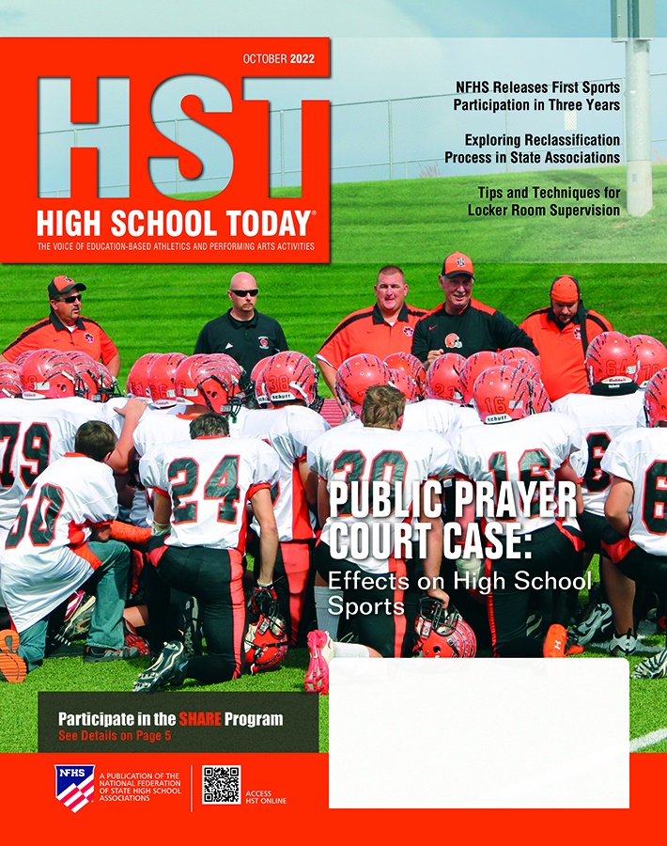


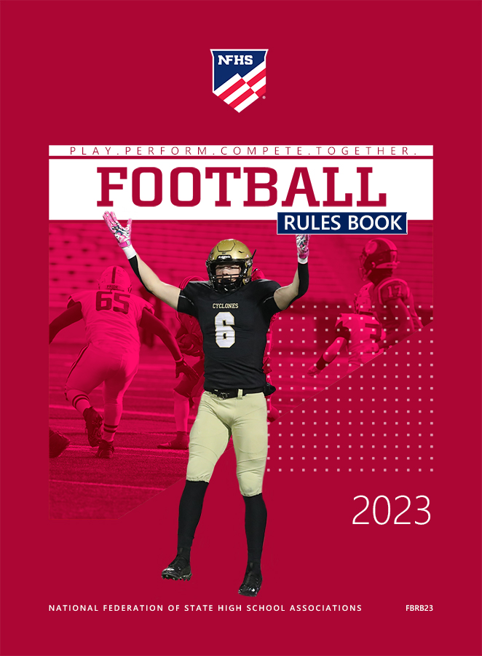
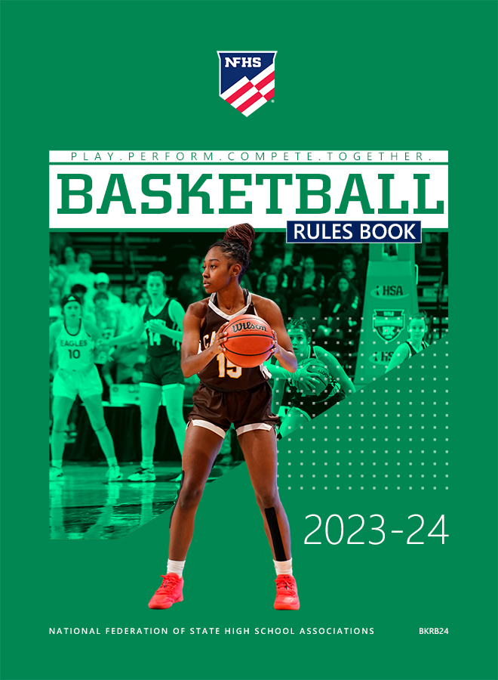

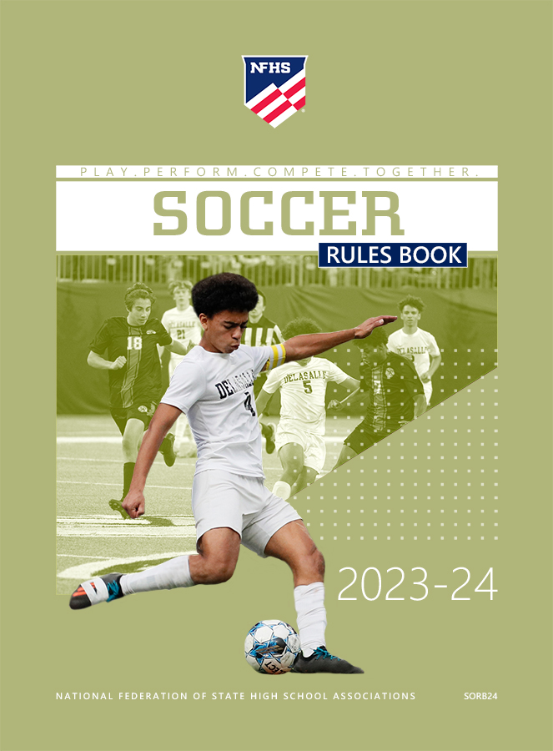






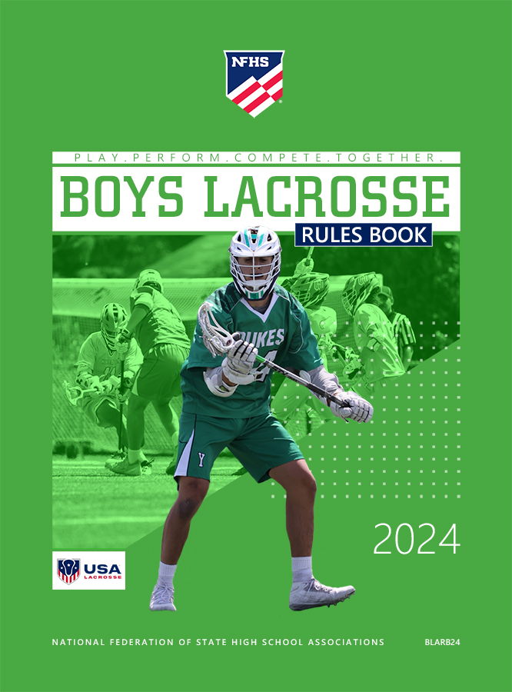
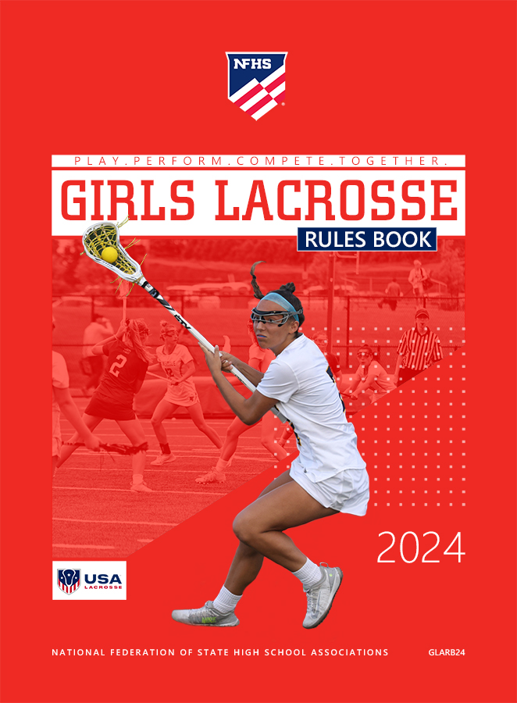
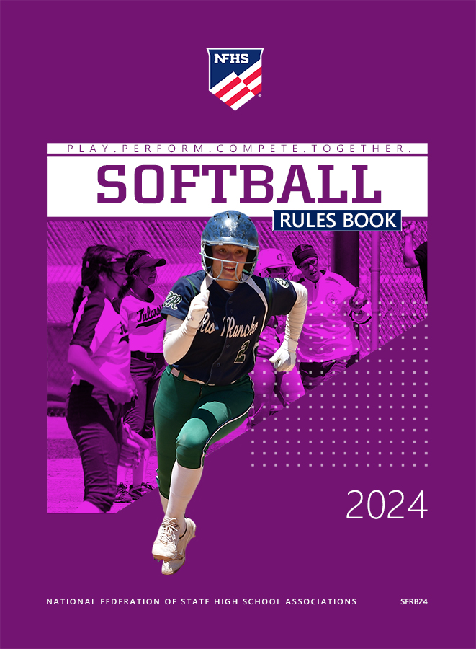

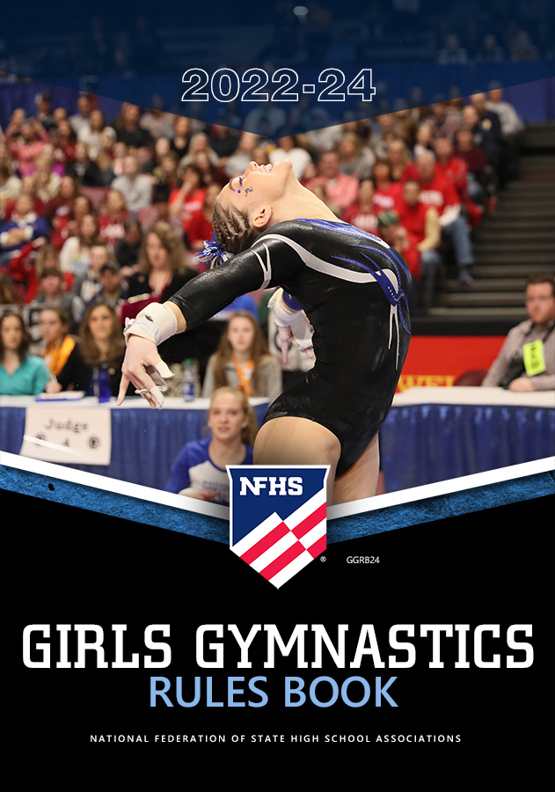
National Federation of
State High School Associations
The NFHS writes playing rules for 17 sports
for boys and girls at the high school level.
  Publishes 4 million pieces of materials annually.

Slide 6
2023-24 nfhs Soccer RULES CHANGES

Slide 7
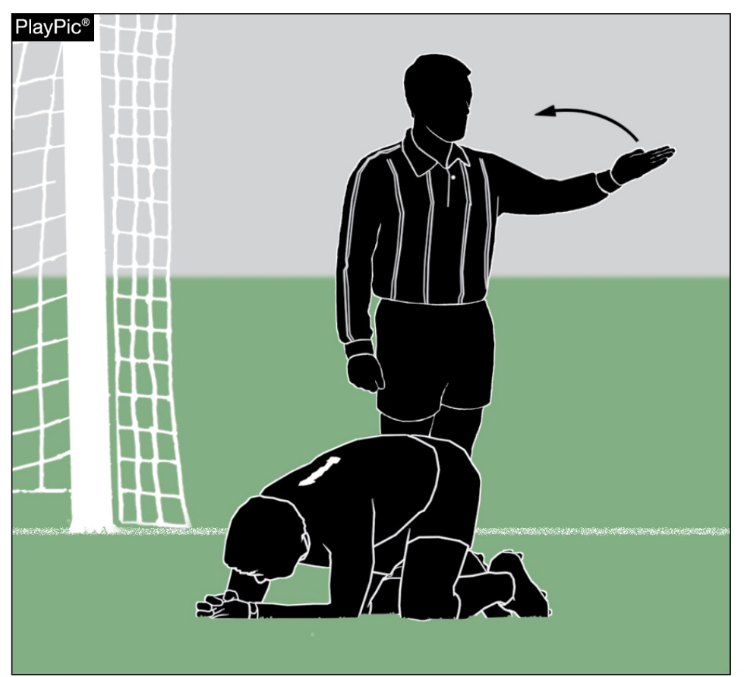
substitutions
3-3-2b (2, 3) (NEW)
The referee may stop the clock to check on a player who appears to be injured.
If the referee beckons sideline personnel to attend to an injured player, the injured player must leave the field.
If the clock was stopped, but the referee did not beckon anyone onto the field, the player may remain in the game.
Notes:
2. The player must leave the field once the referee beckons sideline personnel.
3. If sideline personnel enter the field (without a beckon from the referee), the injured player must leave the field
Rationale: Referee has the authority to stop the clock to review game situations at any time. This rule change affords the ability for the referee to assess situations without negatively effecting a player’s ability to remain in the game. However, once the referee beckons medical professional or coach onto the field to further assess, the player must leave the field of play.
SECTION 3 SUBSTITUTIONS
ART. 2…Time for Substitutions: either team may substitute an unlimited number of players from the bench, provided the players report to the scorer's table or nearest official and are beckoned in as per 3-4-1a:
b. when a player is injured:
2. If the referee stops the clock and beckons a coach or appropriate health-
care professional on to the field for an apparent injury to any field
player or goalkeeper, the field player or goalkeeper will have to shall
leave the field. and the goalkeeper shall be replaced by either a
substitute or a field player. If the referee signals the clock to be stopped
and the health- care professional or coach is not beckoned, the player
does not have to leave the field.
3. The field injured player leaving the field may be replaced from the
bench. If the injured player is the goalkeeper, they shall be replaced by
either substitute or a field player.

Slide 8
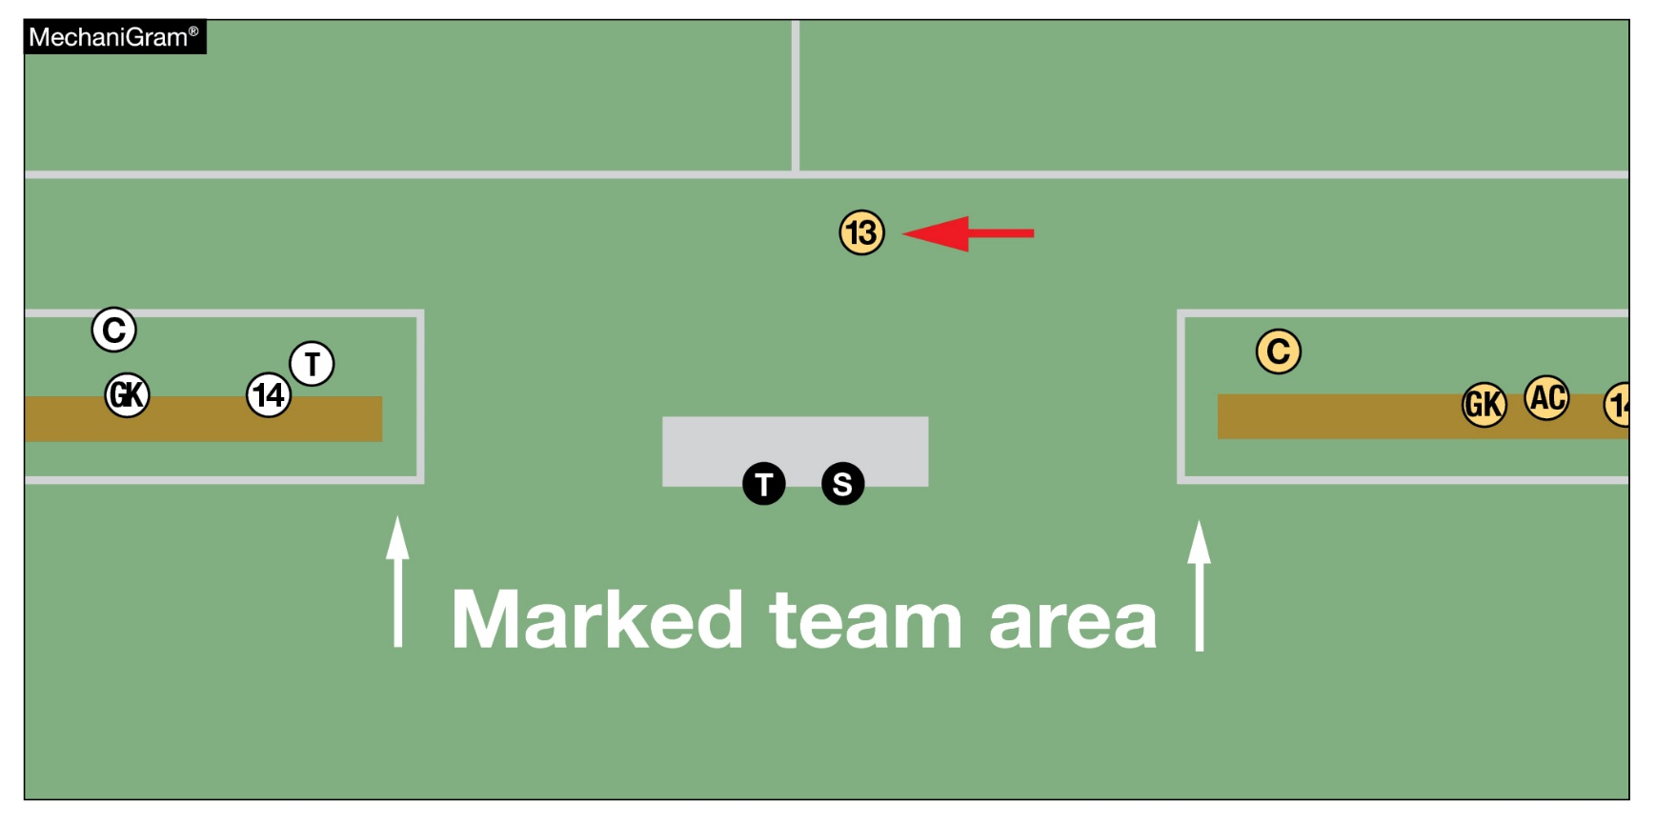
substitutions
3-3-7
A team that elects or is required to play shorthanded for reasons other than misconduct may have the player(s) re-enter the game during a dead ball.
The re-entry shall occur from the official area after being beckoned in as per 3-4-1a.
#13 was asked to leave the field to correct improper equipment and may re-enter at the next dead ball from the official’s area after being beckoned by the referee.
Notes:
SECTION 3 SUBSTITUTIONS
ART. 7 . . . A team that elects or is required to play shorthanded for reasons other than misconduct may have the player(s) re-enter the game during a dead ball. The re-entry shall occur from the official area after being beckoned in as per 3-4-1a.
Rationale: The rule change clarifies that a player should re-enter the game from the official area at midfield. This avoids potential confusion as to who is or is not in the game.

Slide 9
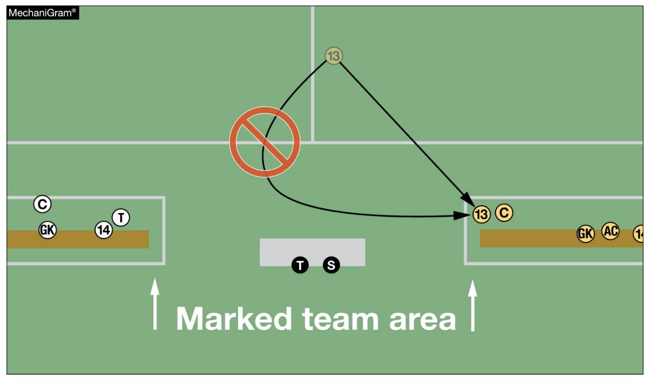
Procedures for substitutions
3-4-1e (NEW)
The player being replaced shall exit the field on the bench side unless the player is injured and unable to exit to that side.
When exiting the field, players shall exit into their team's bench area (and not the opponent's).
#13 must exit toward their team area’s side of the field if able to do so
Notes:
SECTION 1 PROCEDURES FOR SUBSTITUTION
ART. 1 . . . To request a substitution, a substitute who desires to enter the game shall report to the official’s area scorer, giving the jersey number and the number of the player being replaced.
a. The substitute shall remain at the scorer's table official’s area until a referee beckons the substitute onto the field of play. When there is no separate scorer/timer, incoming substitutes shall report directly to the nearest official from the official area.
b. A substitute may enter the field of play at the beginning of a period without being beckoned by the referee. After a goal is scored and when a player is injured and removed from the field, substitutes must be beckoned.
c. If entry is requested at any other time, the scorer shall require the timer to signal for the substitution
d. When an entry is taking place on a throw-in, a goal kick or a corner kick, the substitute(s) must have reported to the scorer (or official area prior to the dead-ball situation.
e. The player being replaced shall exit the field on the bench side unless the player is injured and unable to exit to that side.
Rationale: To assist the officials in the managing of substitutions, players should exit the field from the bench side when the substitute(s) are beckoned on by the referee unless the player(s) is unable to do so because of an injury. This avoids unnecessary interaction with opposing teams and fans and minimizes the potential for unsporting behavior.

Slide 10
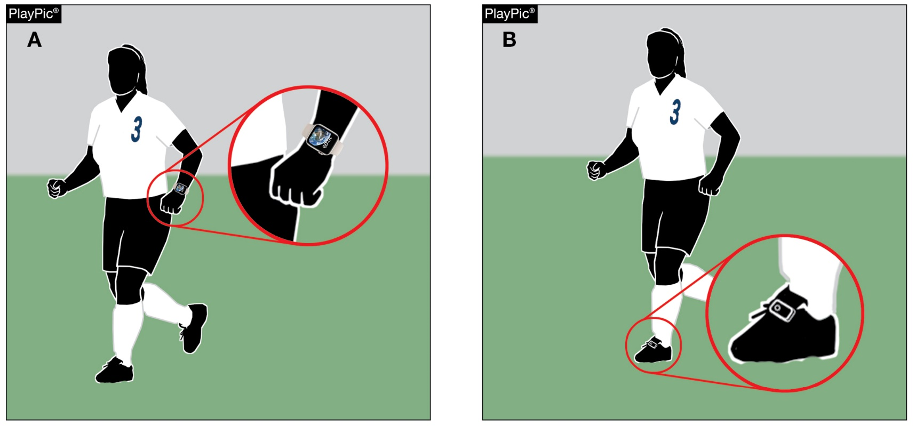
Other equipment
4-2-11 (NEW)
Wearable technology devices are permitted.
Must be secured.
Must not create a safety hazard to any player.
Devices may be worn on the shoes or on the body under the uniform.
Devices may not be worn under the arm below the level of the shoulder.
ILLEGAL – cannot be worn on wrist (below shoulder)
LEGAL – worn on the shoe
Notes:
ART. 12…Wearable technology devices must be securely fastened and not present a risk to the player, teammates, or opponents. Devices may be worn on the shoes or on the body under the uniform but not worn on under the arm.
NOTE: Medical appliances and/or medical devices are not considered wearable technology.
Rationale: Sets a national standard for wearable technology. The change clarifies that these devices can only be safely worn as a part of the shoe and/or under the uniform and not worn on the arm or below the level of the shoulder. Coaches and players are still not permitted to utilize technology to communicate during the game.

Slide 11
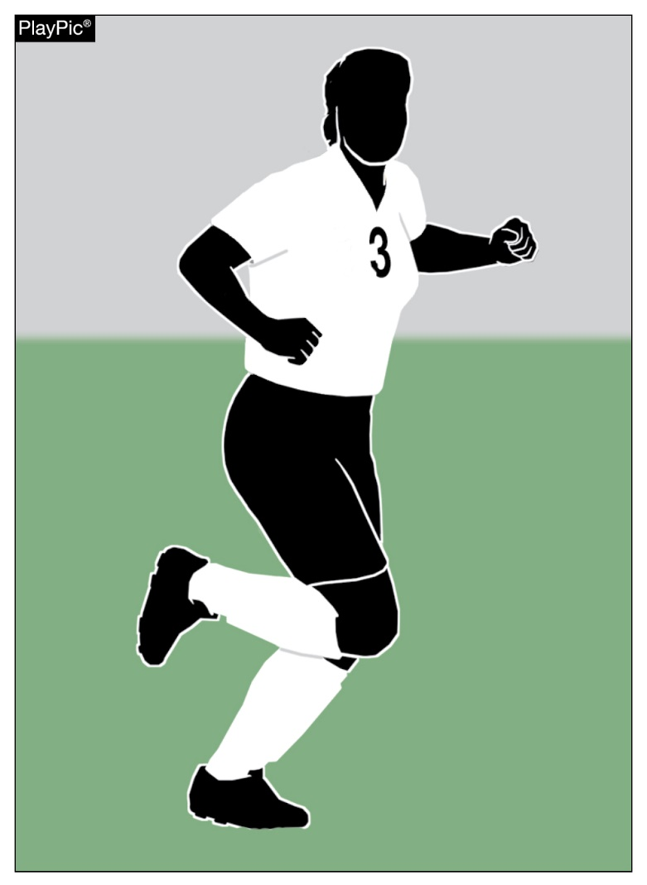
uniform rule 4
The uniform rule has been reorganized to offer clarity.
4-1: Required Uniform
  Art. 1 Requirements
  Art. 2 Jersey
  Art. 3 Shorts
  Art. 4 Socks
  Art. 5 Shinguards
  Art. 6 Shoes
4-2: Other Equipment
4-3: Illegal Equipment
4-4: Coaches’ Responsibilities
Notes:
Rationale: The reorganization of the uniform rule breaks up the rule into bite size pieces that are easier for coaches and officials to apply.

Slide 12
offside
11-1-5 (NEW)
To deliberately play the ball, the player must have time and space, and sufficient sight of the ball to control the ball with the possibility of:
1. Passing the ball to their teammate; or,
2. Gaining possession of the ball; or
3. Clearing the ball
A save is when a player stops, or attempts to stop, a ball which is going into or very close to the goal with any part of the body except the hands/arms (unless the goalkeeper within the penalty area).
Notes:
SECTION 1 OFFSIDE
ART. 5… A player in an offside position receiving the ball from an opponent, who deliberately plays the ball (except from a deliberate save), is not considered to have gained an advantage.
a. To deliberately play the ball, the player must have time and space, and sufficient sight of the ball to control the ball with the possibility of:
1. Passing the ball to their teammate; or,
2. Gaining possession of the ball; or
3. Clearing the ball
b. A save is when a player stops, or attempts to stop, a ball which is going into or very close to the goal with any part of the body except the hands/arms (unless the goalkeeper within the penalty area).
Rationale: Defines the criteria for deliberately playing the ball when determining an offside infraction.

Slide 13
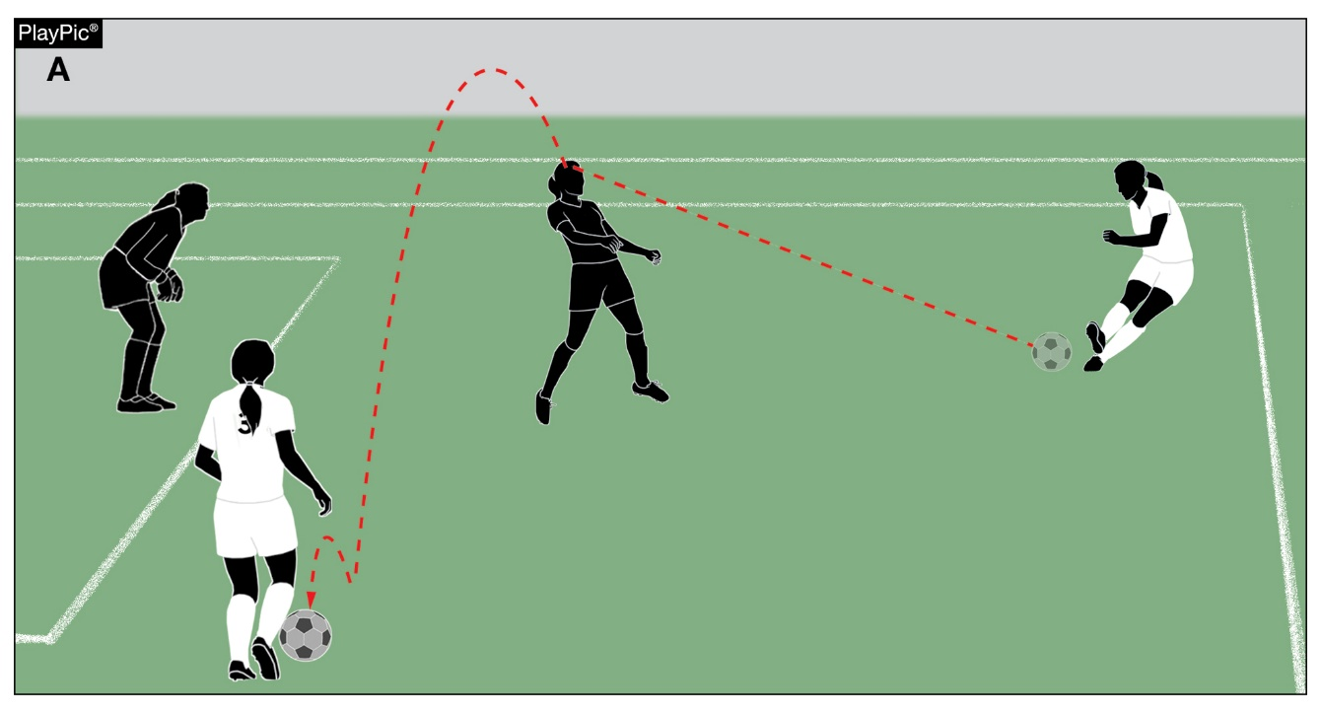
offside
11-1-5 (NEW)
A player in an offside position receiving the ball from an opponent, who deliberately plays the ball (except from a deliberate save), is not considered to have gained an advantage.
In PlayPic A, the second attacker is to be ruled offside because the ball merely glanced off the defender's head (not a deliberate play).
OFFSIDE – deflection off a defender who did not deliberately play the ball

Slide 14
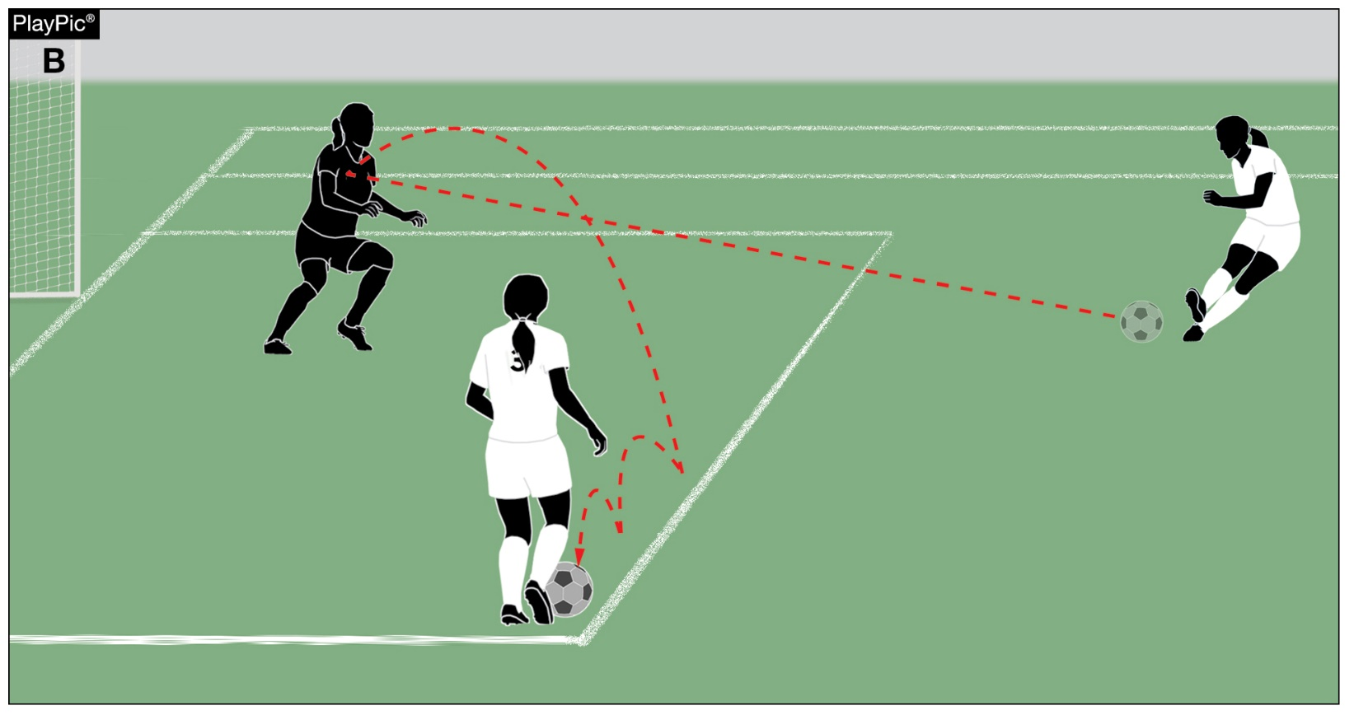
offside
11-1-5 (NEW)
In PlayPic B, the goalkeeper makes a deliberate save. White #3 has committed an offside offense.

Slide 15
fouls
12-1-1 thru 3 (NEW), 18-1-1
This new section defines the seven direct free-kick fouls that must at least rise to the level of careless in order to be called a foul.
Those offenses are (If committed against an opponent):
Charges
Jumps at
Kicks or attempts to kick
Pushes
Strikes or attempts to strike (including head-butt)
Tackles or challenges
Trips or attempts to trip
Notes:
SECTION 1 FOULS
ART. 1 ... Direct and indirect free kicks and penalty kicks can only be awarded for offenses committed when the ball is in play.
ART. 2 ... A direct free kick is awarded if a player commits any of the following offenses against an opponent in a manner considered by the referee to be careless, reckless, or using excessive force.
a. charges;
b. jumps at;
c. kicks or attempts to kick;
d. pushes;
e. strikes or attempts to strike (including head-butt);
f. tackles or challenges;
g. trips or attempts to trip;
ART. 3 ... If an offense involves contact, it is penalized by a direct free kick.
a. Careless is when a player shows a lack of attention or consideration when making a challenge or acts without precaution. No further disciplinary sanction is needed.
b. Reckless is when a player acts with disregard to the danger to, or consequences for, an opponent and must be cautioned (12-8-1f(10)).
c. Using excessive force is when a player exceeds the necessary use of force and/or endangers the safety of an opponent and must be disqualified (12-8-2d(1)).
Rationale: Fouls involving physical contact are generally categorized as careless, reckless, or using excessive force. This new section in rule 12 and added definitions to rule 18 define the seven direct free kick fouls and provides consistency for officials interpreting misconduct.

Slide 16
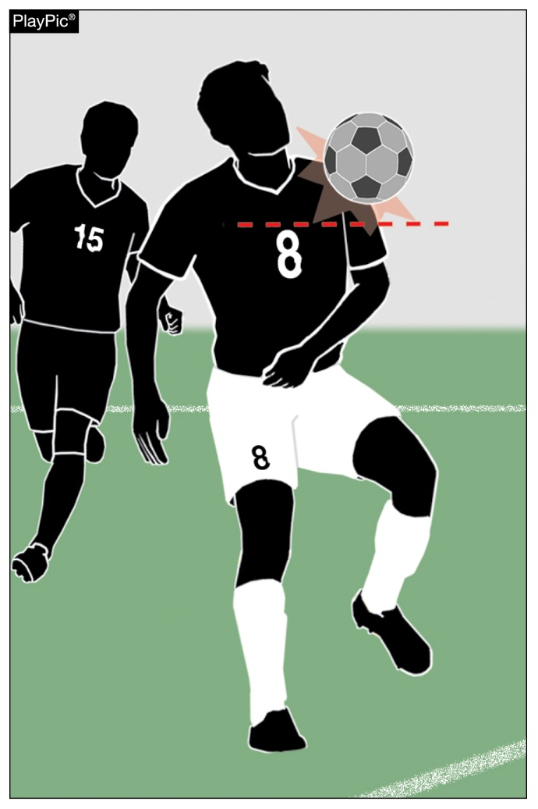
handling
12-3-2, 3 (NEW)
Handling continues to be defined by the armpit. The upper boundary of the arm is in line with the bottom of the armpit.
Attacker 8 is not guilty of handling.
Notes:
SECTION 2 HANDLING
ART. 2… A player shall be penalized for handling if they score in the opponent’s goal directly from their hand/arm, even if accidental, including by the goalkeeper.
ART. 3… A player shall be penalized for handling if they score in the opponent’s goal immediately after the ball has touched their hand/arm, even if accidental.
Rationale: The new articles eliminate the necessity for the referee to determine if the hand/arm contact was accidental or deliberate. Now neither accidental nor deliberate contact with the hand/arm result in a goal for greater consistency and ease of interpretation.

Slide 17
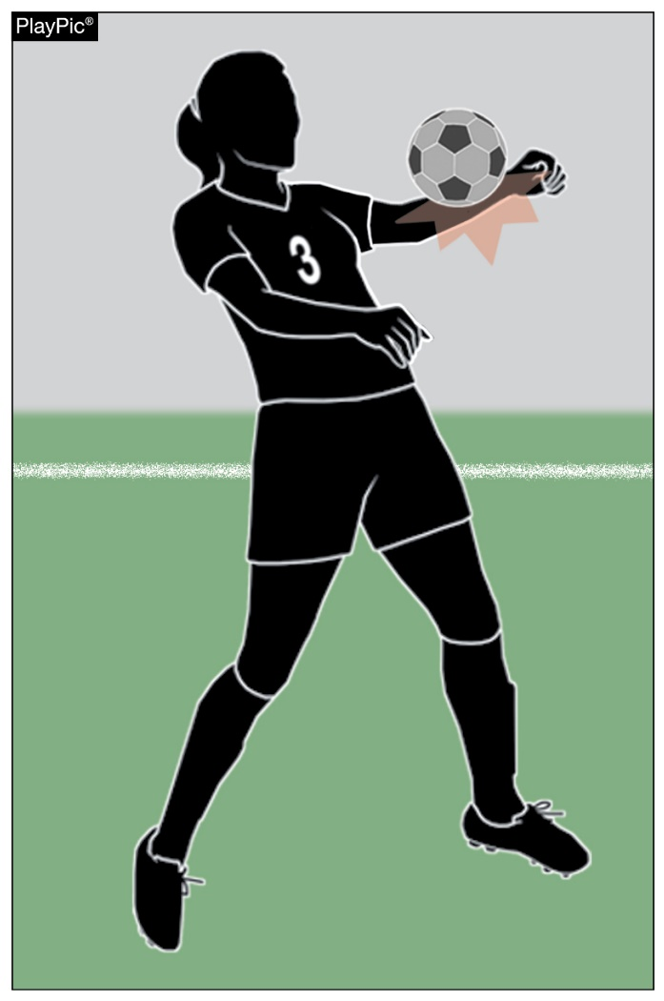
handling
12-3-2, 3 (NEW)
These new articles stipulate a goal cannot be scored if a player (including the goalkeeper) is guilty of handling, even if accidental.
The handling is penalized. This is clearly handling even if accidental.
Notes:
SECTION 2 HANDLING
ART. 2… A player shall be penalized for handling if they score in the opponent’s goal directly from their hand/arm, even if accidental, including by the goalkeeper.
ART. 3… A player shall be penalized for handling if they score in the opponent’s goal immediately after the ball has touched their hand/arm, even if accidental.
Rationale: The new articles eliminate the necessity for the referee to determine if the hand/arm contact was accidental or deliberate. Now neither accidental nor deliberate contact with the hand/arm result in a goal for greater consistency and ease of interpretation.

Slide 18
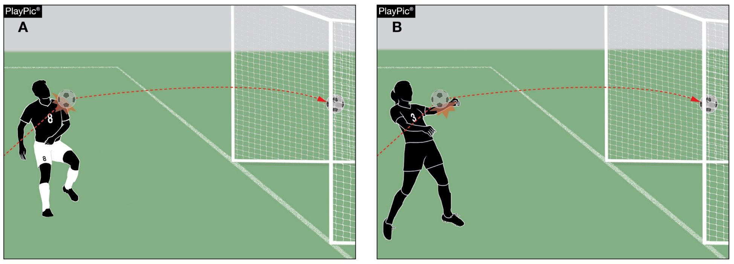
HANDLING
12-3-2, 3 (NEW)
In PlayPic A, attacker #8 is not guilty of handling, the goal is scored.
In PlayPic B, attacker #3 cannot legally score a goal, solely focusing on the handling situation presented, even if handling is ruled accidental, a direct free kick is awarded to the defending team.

Slide 19
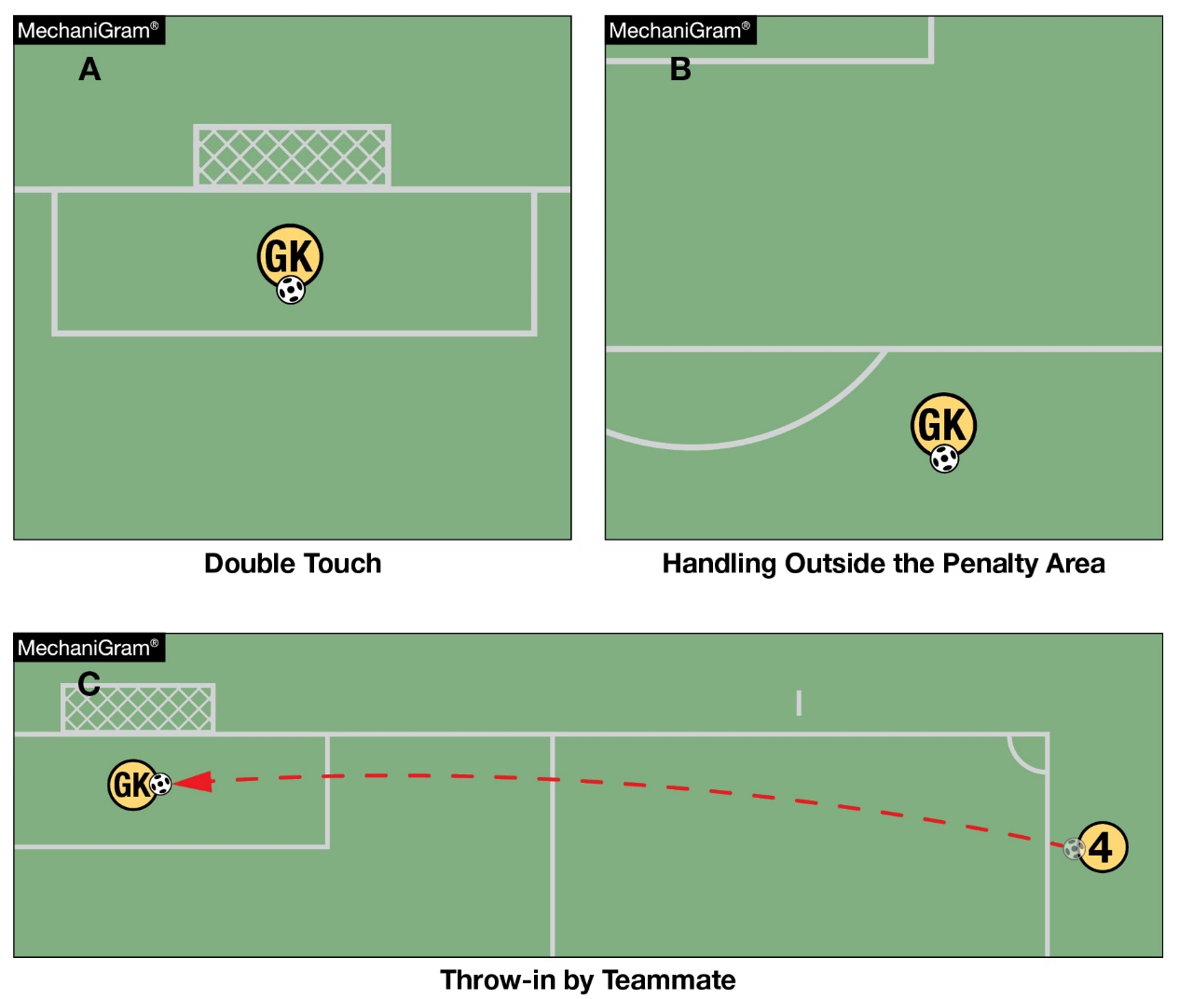
Restrictions on the goalkeeper
12-8-5
The goalkeeper has the same restrictions on handling the ball as any other player outside the penalty area. (PlayPic B)
If the goalkeeper handles the ball inside the penalty area when not permitted to do so, an indirect free kick is awarded but there is no disciplinary sanction. (PlayPics A and C)
Notes:
SECTION 7 RESTRICTIONS ON THE GOALKEEPER
ART. 5 . . . The goalkeeper has the same restrictions on handling the ball as any other player outside the penalty area. If the goalkeeper handles the ball inside their penalty area when not permitted to do so, an indirect free kick is awarded but there is no disciplinary sanction. However, if the violation is playing the ball a second time (with or without the hand/ arm) after a restart before it touches another player, the goalkeeper must be cautioned if the offense stops a promising attack or ejected if the offense denies an opponent or the opposing team a goal or an obvious goal-scoring opportunity.
Rationale: Adding language and direction for officials regarding goalkeeper handling outside the penalty area and inside the penalty area when they are not permitted to handle the ball.

Slide 20
Restrictions on the goalkeeper
12-8-5
If the violation is playing the ball a second time after a restart before it touches another player, the goalkeeper must be cautioned if the offense stops a promising attack or disqualified if the offense denies an opponent or the opposing team a goal or an obvious goal-scoring opportunity (DOGSO).

Slide 21
misconduct
12-9-4
Denying a goal or an obvious goal-scoring opportunity (DOGSO) defined.
To determine if an offense meets the DOGSO criteria, the following must be considered:
1. Distance between the offense and the goal.
2. General direction of the play.
3. Likelihood of keeping or gaining control of the ball.
4. Location and number of defenders.
Notes:
SECTION 8 MISCONDUCT
ART. 4 ... Denying a goal or an obvious goal-scoring opportunity (DOGSO):
a. When determining if an offense denies an obvious goal-scoring opportunity, the following must be considered and present for a DOGSO offense:
1. distance between the offense and the goal;
2. general direction of the play;
3. likelihood of keeping or gaining control of the ball;
4. location and number of defenders;
b. Where a player commits an offense against an opponent within their own penalty area which denies an opponent an obvious goal-scoring opportunity and the referee awards a penalty kick, the offender is cautioned if the offense was an attempt to play the ball; in all other circumstances (e.g. holding, pulling, pushing, no possibility to play the ball, etc.) the offending player must be disqualified.
c. Where a player denies the opposing team a goal or an obvious goal-scoring opportunity by committing a deliberate handling offense, except a goalkeeper within their penalty area, the player is disqualified wherever the offense occurs.
Also referenced in 12-9-1f (14, 15) and 12-9-2d (3, 4)
Rationale: This rule defines the considerations of an obvious goal-scoring opportunity to provide additional consistency and clarity for referees.

Slide 22
DOGSO Inside/Outside the Penalty Area
DOGSO offenses committed OUTSIDE the penalty area where a goal is not scored are sanctioned with a disqualification (12-9-2d(3)).
If a defender commits a DOGSO foul INSIDE their penalty area resulting in a penalty kick:
If the offender was attempting to play the ball, they are cautioned (12-9-1f(15)).
For all other offenses (e.g., holding, pulling, pushing, no possibility to play the ball, etc.) the offender is disqualified (19-9-2d(4)).
DOGSO offenses committed by deliberately handling the ball (other than the goalkeeper) and a goal is not scored are sanctioned with a disqualification, regardless of where the handling occurred (12-9-2d(2)).
Notes:
Although it is not expressly listed as an example, an indirect free kick foul inside the penalty area that is ruled a DOGSO would be a disqualification, falling into the "in all other circumstances" clause of the rule and potentially also under the example "no possibility to play the ball" or "etc.".

Slide 23
Misconduct Examples
12-9-4
Scenario ONE:
If a player carelessly slide tackles their opponent, which is a play on the ball, denying an obvious goal scoring opportunity, they will be disqualified for DOGSO if this foul is located outside the penalty area: the offender is disqualified per 12-9-2d(3), their team must play short-sided, and play restarts with a direct free kick.
If committed inside the penalty area, they are cautioned for unsporting conduct and a PK is awarded per 12-9-1f(15).

Slide 24
Misconduct Examples
12-9-4
Scenario TWO:
If a player tackles their opponent using excessive force inside the penalty area, the offender is disqualified for serious foul play. Even though their foul, may also be a DOGSO inside the penalty area from a play on the ball, the nature of the foul rises to the level of disqualification per 12-9-2d(1).
The offender is disqualified for serious foul play, a penalty kick is awarded, and the offender's team must play short-sided.

Slide 25
Misconduct Examples
12-9-4
Scenario THREE:
A defender, other than the goalkeeper, who deliberately handles the ball and stops a goal from being scored will always be disqualified for DOGSO regardless of where the handling offense occurs per 12-9-2d(2), provided the other considerations of DOGSO apply.

Slide 26
NEW/Revised definitions
18-1-1
A total of five definitions were added or revised to Rule 18-1-1.
The terms Careless, Excessive Force, Serious Foul Play and Tactical Fouls were added to the Rules Book.
The term Violent Conduct was revised.
Notes:
c. CARELESS - When a player shows a lack of attention or consideration when making a challenge or acts without precaution. No disciplinary sanction is needed beyond awarding a direct free kick.
n. EXCESSIVE FORCE - Using excessive force is when a player exceeds the necessary use of force and/or endangers the safety of an opponent and must be disqualified.
oo. SERIOUS FOUL PLAY - A tackle or challenge that endangers the safety of an opponent or uses excessive force or brutality must be sanctioned as serious foul play resulting in disqualification. Any player who lunges at an opponent in challenging for the ball from the front, from the side, or from behind using one or both legs, with excessive force or endangers the safety of an opponent is guilty of serious foul play.
vv. Tactical Fouls - A tactical foul is committed to stop a promising attack or deny an obvious goal-scoring opportunity.
vv. zz. VIOLENT CONDUCT - Violent conduct is when a player uses or attempts to use excessive force or brutality against an opponent when not challenging for the ball, or when a player, substitute, or bench personnel commits a violent act against an opponent, teammate, substitute, bench personnel, official, spectator, or any other person, regardless of whether contact is made, or if the ball is in or out of play. In addition, a player who, when not challenging for the ball, deliberately strikes an opponent or any other person on the head or face with the hand or arm, is guilty of violent conduct unless the force used was negligible.
Rationale: Fouls involving physical contact are generally categorized as careless, reckless, or using excessive force. Direct free kick fouls to provide consistency for officials interpreting misconduct.

Slide 27
2023-24 NFHS Soccer editorial change

Slide 28
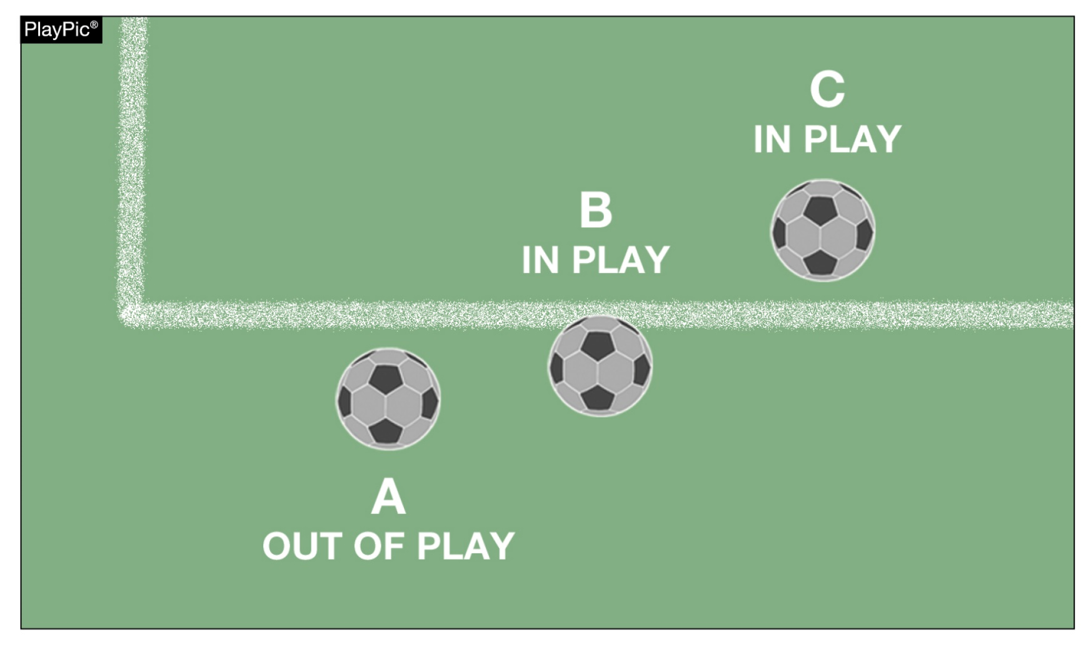
In play and out of play
9-1-1 (a & b)
The ball is out of play when it has completely crossed a goal line or touchline, whether on the ground or in the air.
This diagram was moved in the Rules Book to better align with the corresponding text.
Notes:
Rationale: The graphic was moved to the proper location in the rules book.

Slide 29
2023-24 nfhs soccer points of emphasis

Slide 30

Wearable technology
Wearable technology is permitted in certain instances.
Coaches and officials must review the Rule Change to Rule 4-2-12 (earlier in this presentation).
ILLEGAL – cannot be worn on wrist (below shoulder)
LEGAL – worn on the shoe
Notes:
Rationale: Sets a national standard for wearable technology. The change clarifies that these devices can only be safely worn as a part of the shoe and/or under the uniform and not worn on the arm or below the level of the shoulder. Coaches and players are still not permitted to utilize technology to communicate during the game.

Slide 31
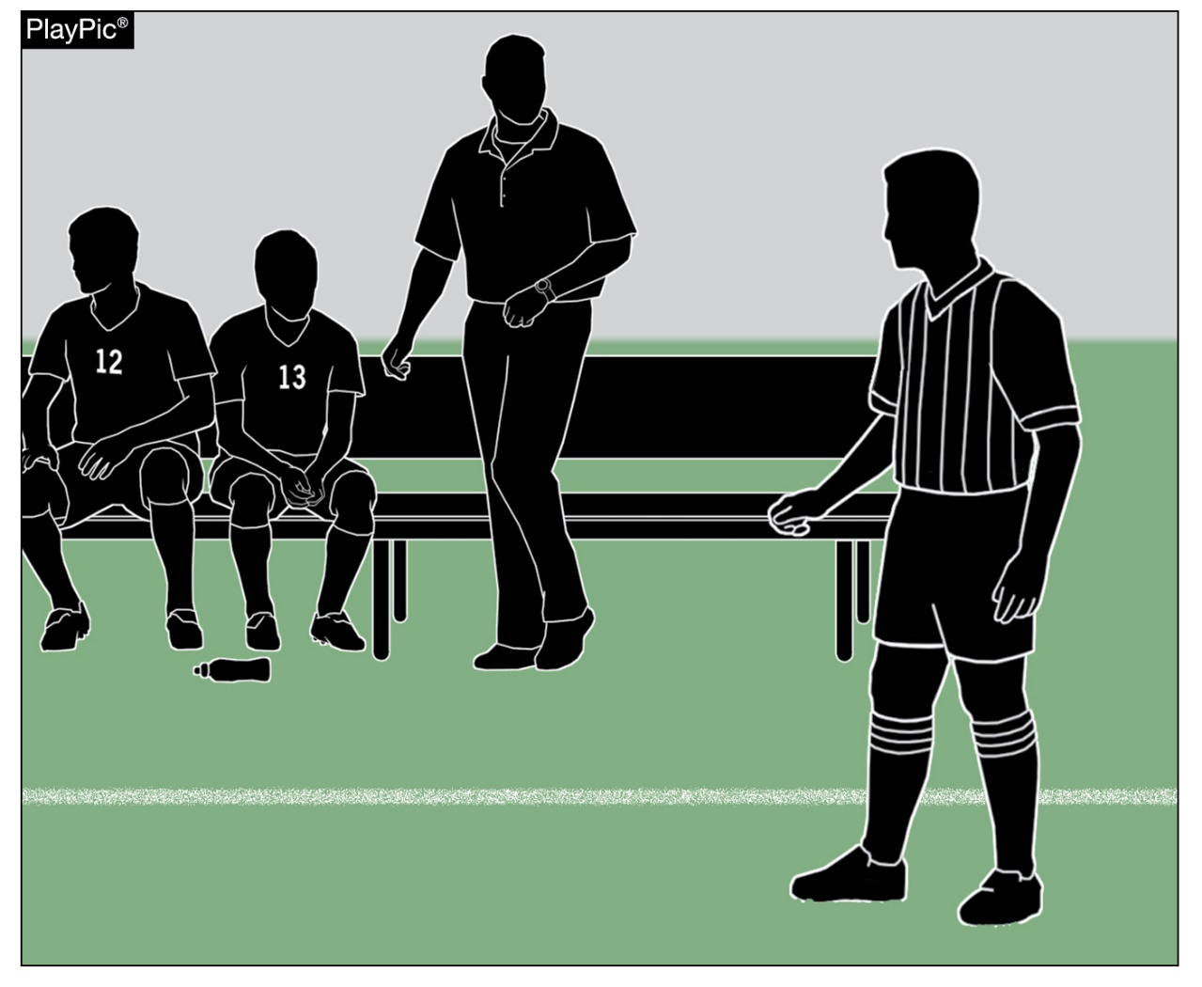
Coaching and team Area decorum
Coaches set the tone with display of sportsmanship.
Officials focus on action of players, coaches and other bench personnel.
An open line of communication between officials and coaches makes for a better game.
Notes:
Coaches set the tone for the contest with their display of sportsmanship. Officials should focus on the actions of players, coaches and other bench/sideline personnel. A positive, open line of communication between officials and coaches ultimately results in a better contest for everyone involved.

Slide 32
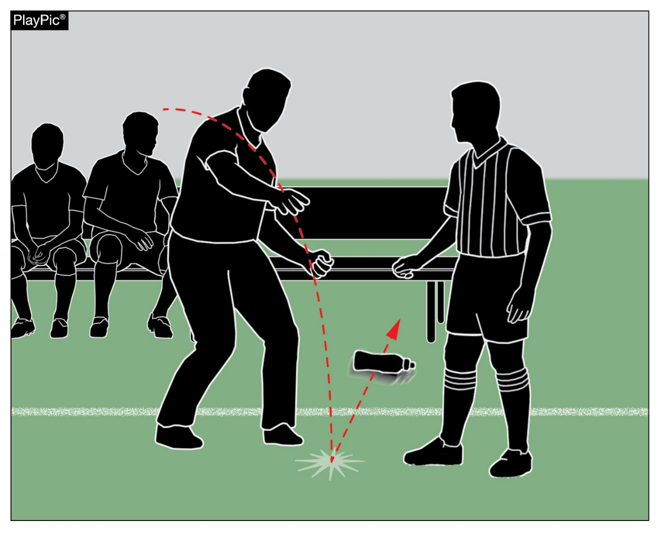
COACHING AND TEAM AREA DECORUM
Examples of inappropriate decorum:
  Kicking or throwing objects in reaction to decision.
  Entering the field to dissent or confront an official.
  Acting in a provocative or inflammatory manner.
  Arguing calls constantly.
Referees must manage this type of behavior.

Slide 33
DENYING AN OBVIOUS GOAL SCORING OPPORTUNITY (DOGSO)
Denying an Obvious Goal Scoring Opportunity (DOGSO) is an egregious attempt to prevent opponents from scoring.
For a player to be sent off for denying and obvious goal-scoring opportunity the following four criteria must be present:
Distance between the offense and the goal (the offense must be near the goal).
General direction of play (the attacking players are generally headed toward the goal).
Likelihood of keeping or gaining control of the ball (the player must have or been able to control the ball in order to score).
Location and number of defenders (If another defender, including the goalkeeper is in a closed enough position to make a lawful tackle or attempt a save then this criteria is not met).
If any element is missing, the player cannot be sent off for denying an obvious goal-scoring opportunity.
Notes:
Although Rule 12 describes the various sanctions in place when an opponent is denied an obvious goal scoring opportunity, the rules have not offered guidance or criteria for DOGSO in the past.

Slide 34
DENYING AN OBVIOUS GOAL SCORING OPPORTUNITY (DOGSO)
Questions to ask when judging on the four considerations:
Where does the offense occur on the field?
Did the foul occur inside or outside the penalty area?
What is the distance between the offense and the goal?
What is the direction of play?
Does the player have control of the ball?
Can the player gain control of the ball?
How many defenders are involved in the situation?
Where are the defenders located?
Does the offense lead to a direct free kick or an indirect free kick?
If no offense were to occur, would the player have an obvious opportunity to score a goal?
Does the player deliberately handle the ball to deny the opposing team a goal?
Was the offender attempting to play the ball?
Notes:
There is much to be considered when evaluating if a play is DOGSO or not. Officials must think of all these items quickly when judging the four considerations on the previous slide.

Slide 35
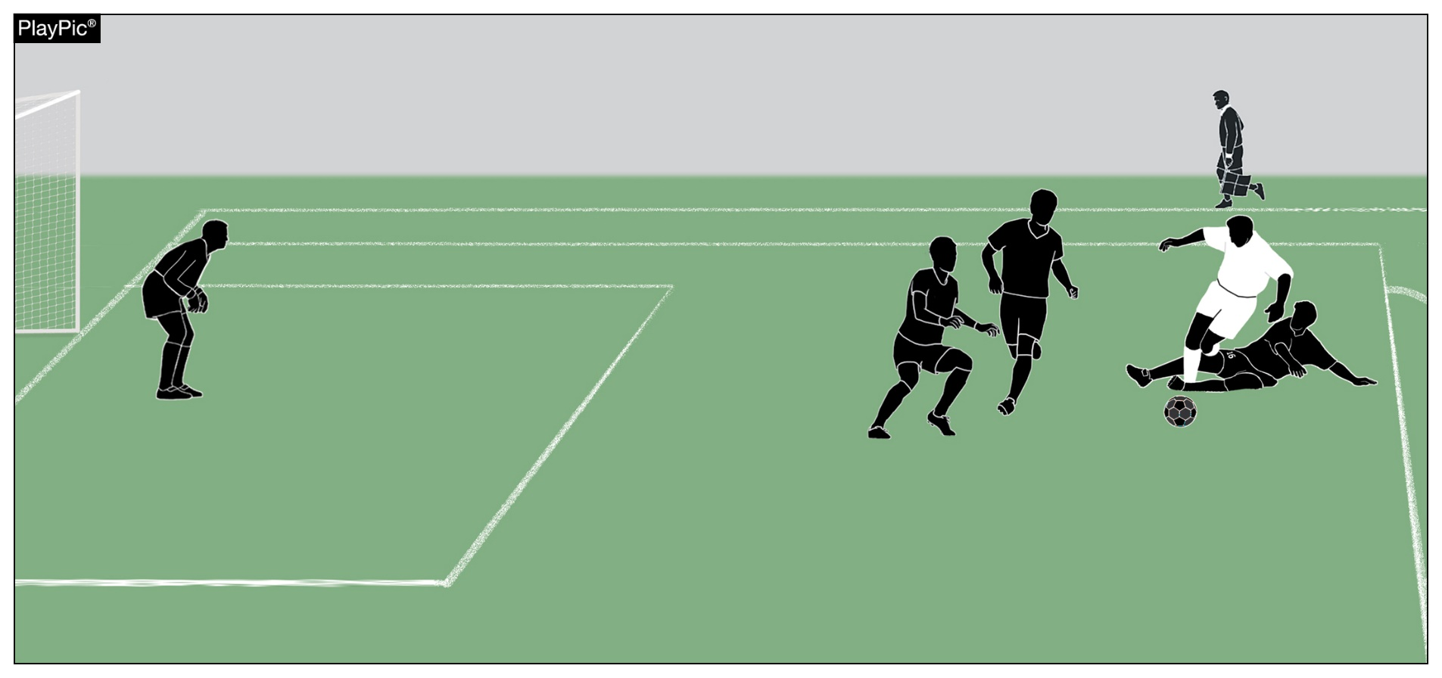
DENYING AN OBVIOUS GOAL SCORING OPPORTUNITY (DOGSO)
In this PlayPic, the referee must consider all questions from the previous slide.
Based on the information available - NOT DOGSO.
Correct,given that three players remain to defend.

Slide 36
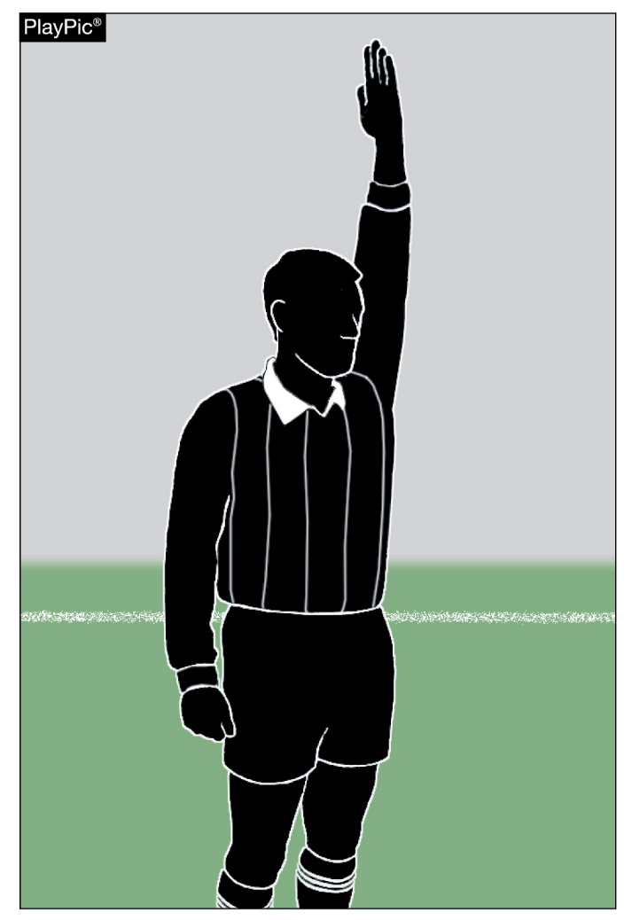
DENYING AN OBVIOUS GOAL SCORING OPPORTUNITY (DOGSO)
Remember – Offenses which deny a goal-scoring opportunity are not limited to a foul that would result in a direct free kick or penalty kick.
Offenses may include fouls that would result in an indirect free kick.
Notes:
Although it is not expressly listed as an example, an indirect free kick foul inside the penalty area that is ruled a DOGSO would be a disqualification, falling into the "in all other circumstances" clause of the rule and potentially also under the example "no possibility to play the ball" or "etc.".

Slide 37
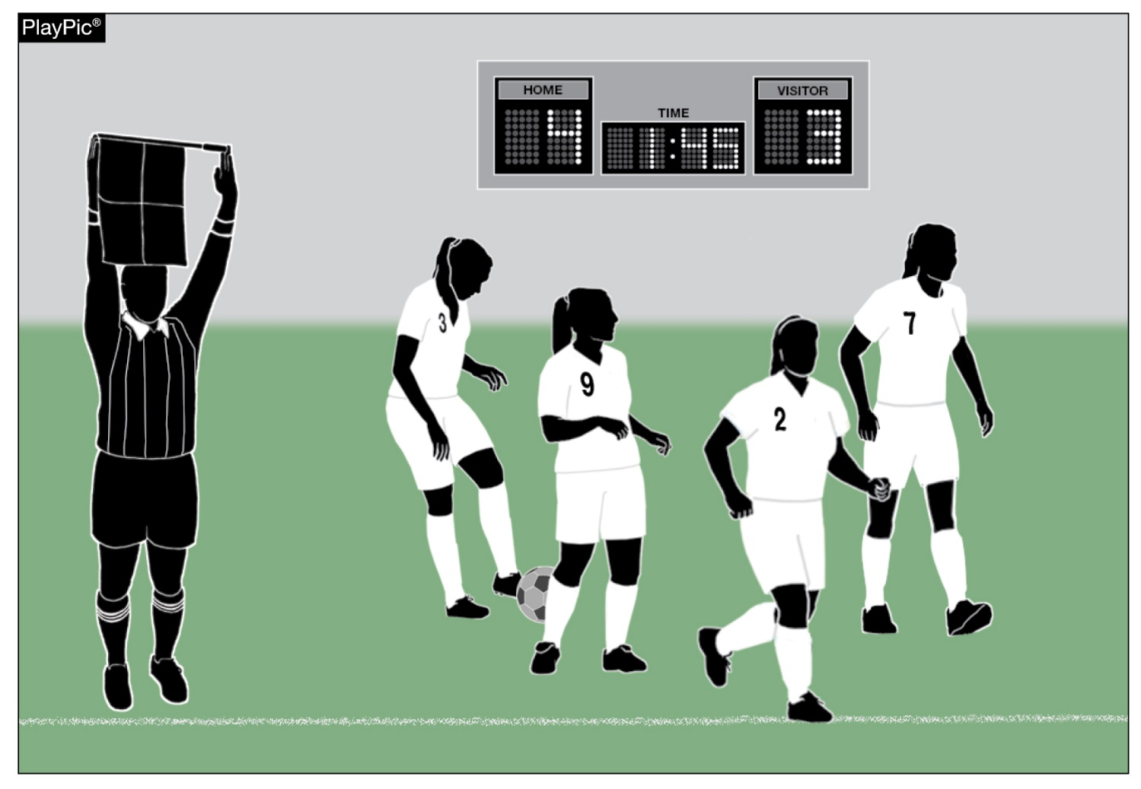
substitution
When do substitutions typically occur?
  Throw-in, goal kick, corner kick, after goal, half time, injury.
Replaced player – exits field on bench side unless unable to do so.
Substitutes must be beckoned by the referee.

Slide 38
NFHS OFFICIALS Education

Slide 39
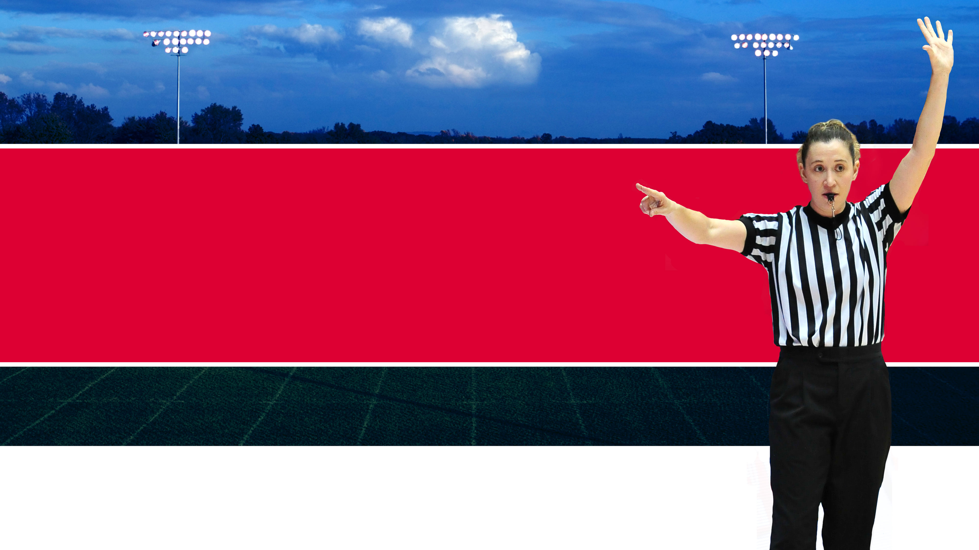




OFFICIALS EDUCATION
Content remains free of charge
TEACHING
AIDS
RULES
CHANGES
DIAGRAMS
VIDEO
LIBRARY
OFFICIALS
COURSES
Notes:
Sport-Specific Officiating courses are offered in several sports. They are ideal for new officials and those in the first few years of officiating. These courses introduce officials to the mechanics and techniques used in the sport and provide specific information on an area within that sport. Individuals can complete a course within 30-45 minutes. These courses are free to all officials and prospective officials.
“Interscholastic Officiating” is a general course on sports officiating, and it is free to all officials and prospective officials. This course provides an introduction to skills and concepts used as an official. Several topics are covered such as: basics of becoming and staying an official, science of officiating, art of officiating, how to combine these skills for successful officiating.
Video clips are made available to NFHS Officials Association members. The video is clipped on specific topics and provides the rules references as well as dialogue on the topic.
The courses and videos are offered at www.NFHSLearn.com .
Courses Available:
Officiating Football
Officiating Volleyball – Ball Handling
Officiating Volleyball – Alignment
Officiating Volleyball – E-Whistle
Officiating Basketball
Officiating Basketball – Three-Person Mechanics
Officiating Basketball - Pre-Game Conference
Soccer – Fouls and Misconduct
Soccer – Offside
Soccer - Pre-Game Conference
Swimming and Diving
Officiating Wrestling
Umpiring Softball
Officiating Field Hockey
Officiating Track and Field
Future Courses to be Considered:
Umpiring Baseball
Umpiring Softball – 2 Person Mechanics
Communication Among Officials and Coaches

Slide 40
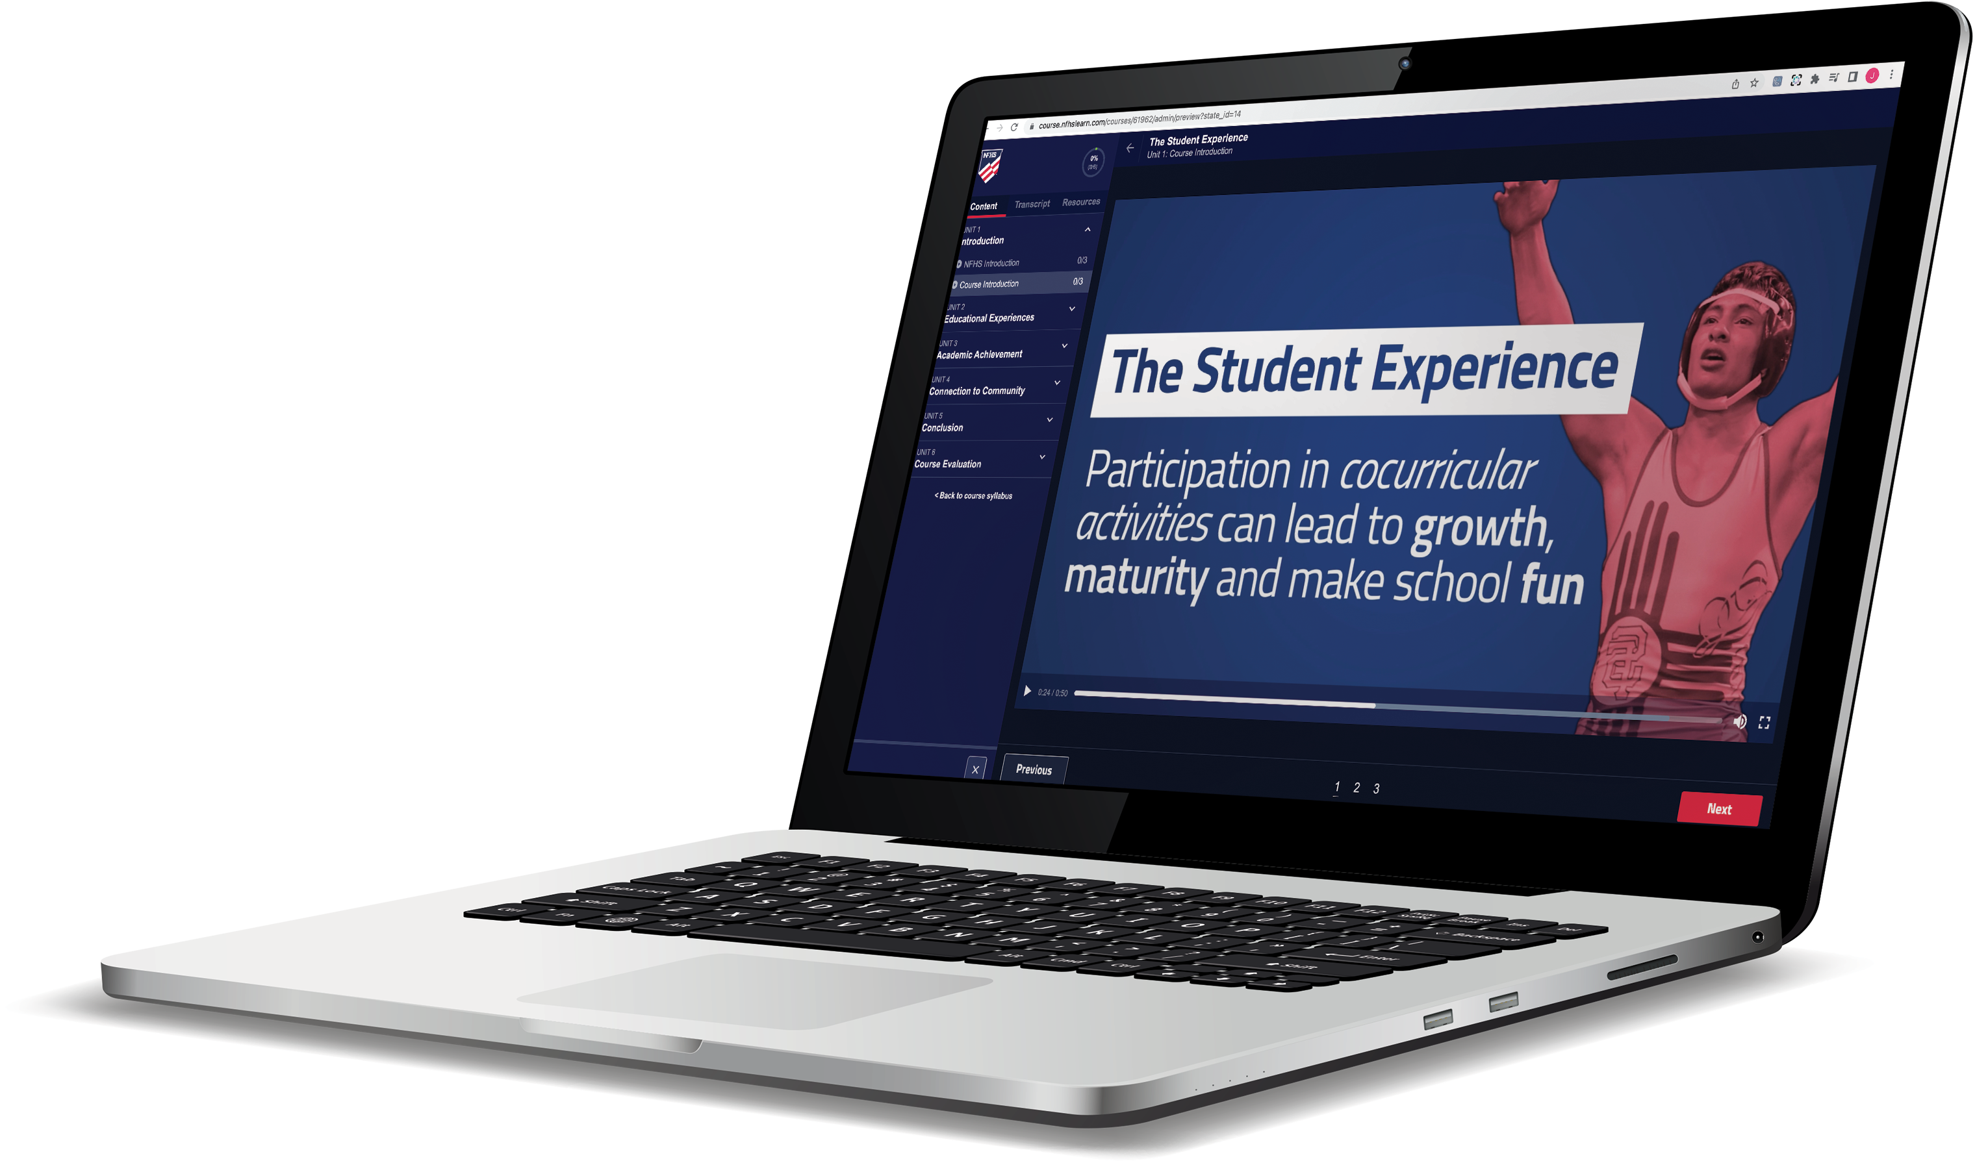
Over 17.8 million courses delivered!
Concussion in Sports – 7M
Heat Illness Prevention – 2.1M+
Sudden Cardiac Arrest – 2.2M+
The Collapsed Athlete (2020) – 51,000+
Concussion for Students – 1.1M+
Implicit Bias (2021) – 90,000+
Fundamentals of Coaching – 900,000+
First Aid, Health and Safety – 400,000+
Protecting Students from Abuse – 220,000+
Student Mental Health and Suicide Prevention – 227,000+
Bullying, Hazing and Inappropriate Behaviors – 400,000+
Appearance & Performance Enhancing Drugs and Substances – 118,000+
COVID-19 for Coaches and Administrators – 360,000+

Slide 41
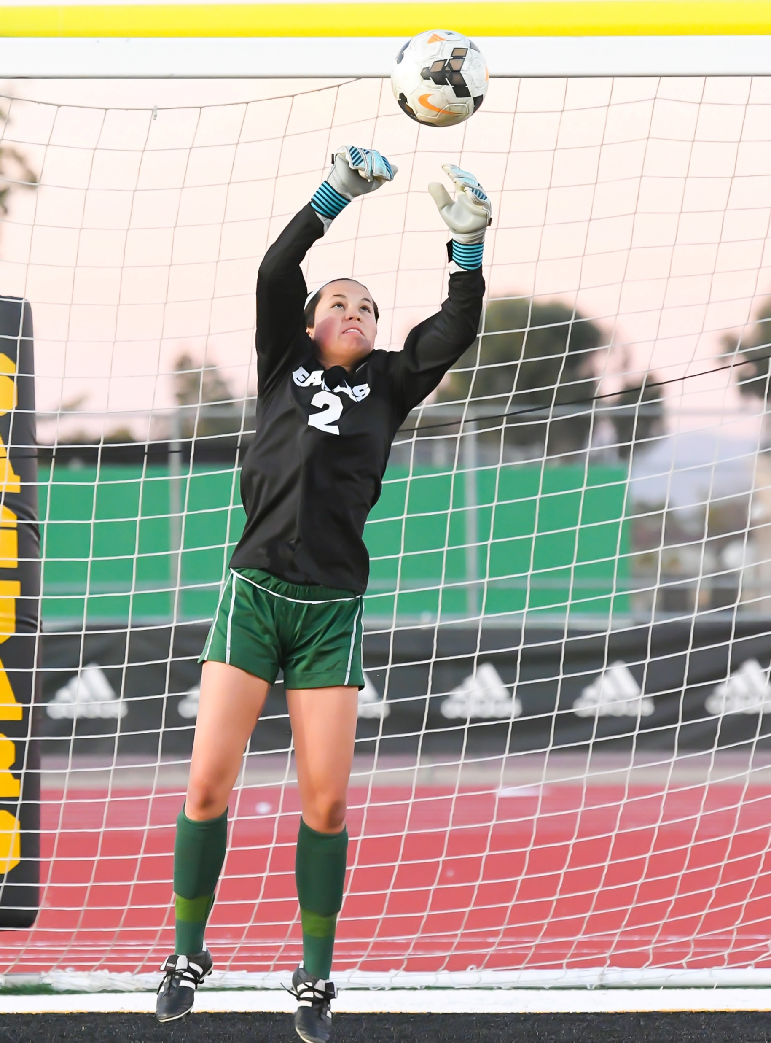
Thank You
National Federation of State High School Associations
PO Box 690 | Indianapolis, IN 46206
Phone: 317-972-6900 | Fax: 317.822.5700
www.nfhs.org | www.nfhslearn.com | www.nfhsnetwork.com

